Slide 1
Divvy Organisation (Chicago) Bike Sharing System
Analysis by Pallavi Dalvi

Slide 2
Introduction and Preliminary Analysis
A bicycle-sharing system, public bicycle scheme, is a service in which bicycles are made available for shared use to individuals on a short-term basis for a price or free.
Data analysed for
Trips for year 2016
Trips for year 2017
Trips for year 2018
Trips for year 2019
Stations
Quick Stats
Year | No of Bikes
2016 | 5748
2017 | 6243
2018 | 6133
2019 | 6017
Year | No of Trips
2016 | 3595383
2017 | 3829003
2018 | 3603082
2019 | 3818004

Slide 3
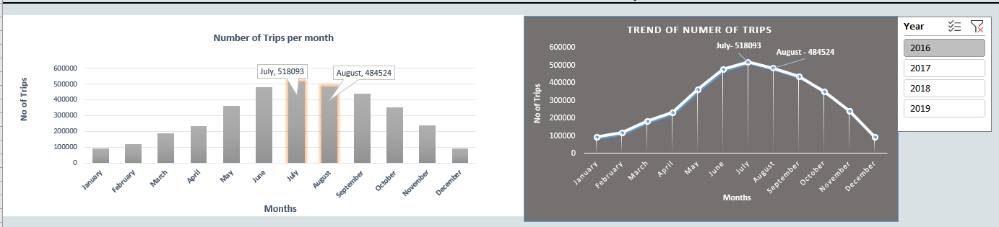
Trends And Descriptive Analysis
Number of Trips Per Month Per Year
Highest No of Trips are taken place in Months JULY and AUGUST

Slide 4
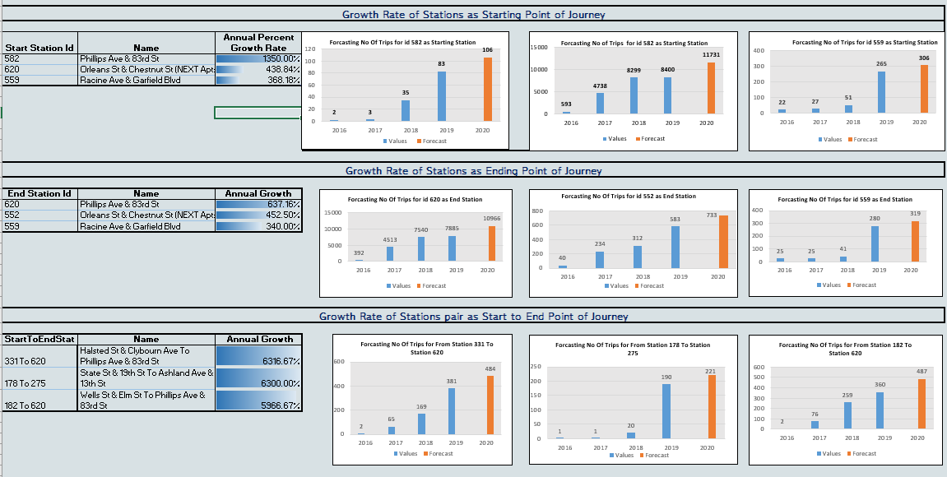
Trends And Descriptive Analysis cntd…
Stations with Highest Annual Growth Rate and Forecast for Year 2020

Slide 5
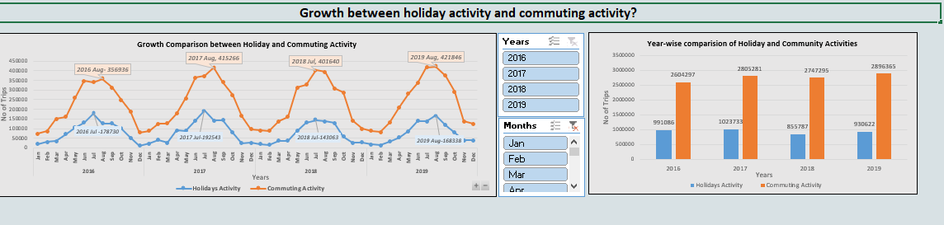
Trends And Descriptive Analysis cntd…
Growth between holiday activity and commuting activity?

Slide 6
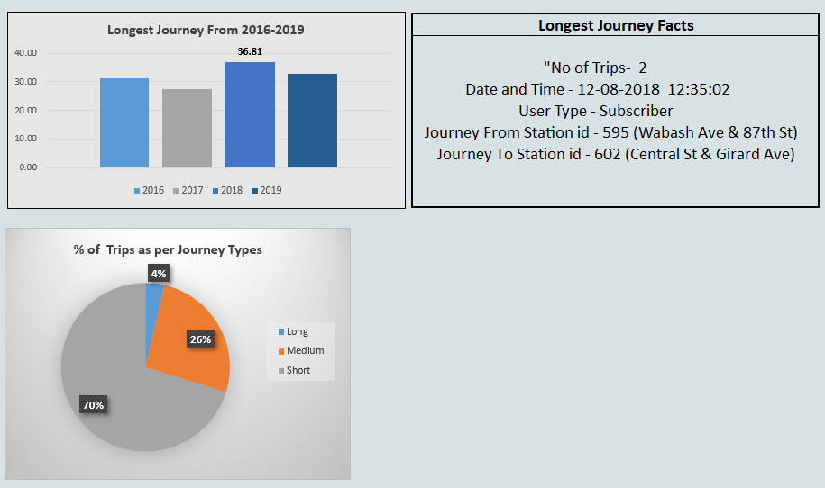
Geospatial Analysis
Longest Journey Analysis

Slide 7
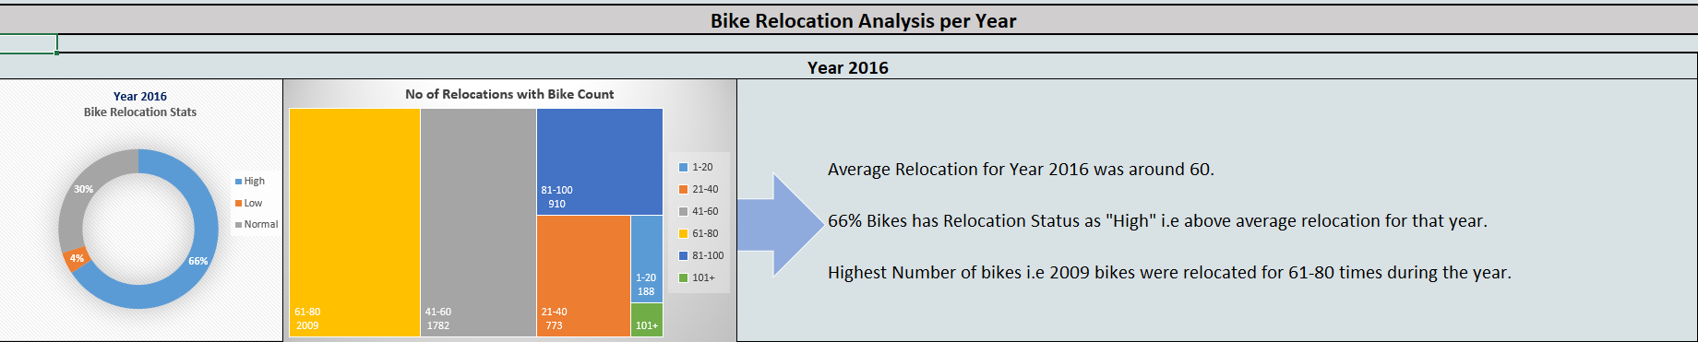
Geospatial Analysis cntd…
Bike Relocation Analysis per Year

Slide 8
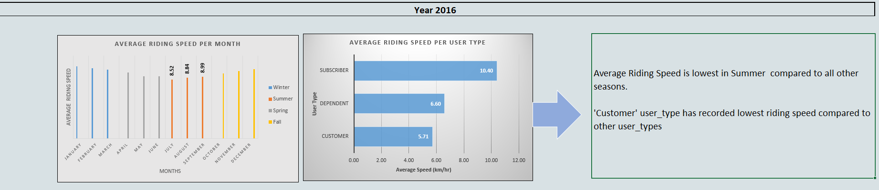
Geospatial Analysis cntd…
Rider Speed Analysis

Slide 9
THANK YOU

